Slide 1
Practical I
Thursday, 26 January 2023, 2pm – 5pm
Department of Biology, University of Oxford

Slide 2
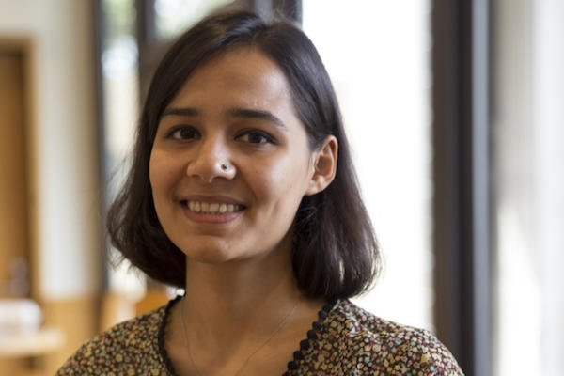


Demonstrators/Instructors
Sumali, (she/her)
Main research: Equity in disease transmission and statistical inference
Rhys, (he/him)
Main research: Genomic epidemiology and sampling biases
Moritz, (he/him)
Main research: Spatio-temporal dynamics of infectious diseases

Slide 3
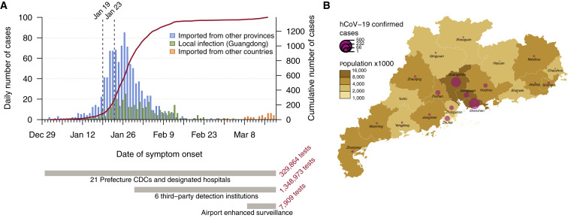
What are we learning today?
About infectious disease surveillance data
How to analyse case count data using the R-package ‘EpiEstim’
Specifically estimating the time varying reproduction number Rt

Slide 4
How are we learning today?
There are handouts on Canvas with questions and example code
We take a break after ca. 1 ½ hours for about 15 minutes and you can also take your own short breaks during the session
Raise your hand should you need assistance or have specific questions
At the end we will have a short 15-minute wrap up session
Early next week we will give you access to model answers and you can email us with any questions after as well

Slide 5
R-Markdown: a quick intro
Format for writing reproducible and dynamic reports within R
To create an R-markdown open R Studio click on “File” > “New File” > “R Markdown”
In the editor window you can add code, text and formatting through the Markdown language e.g. # = headings or - = bullet points
To insert code, you can use the {r} and ’ syntax to create code chunks e.g. ‘’’{r} x <- 5
These chucks can be run independently or be knitted together in the desired format to create a PDF or HTML

